Slide 1



Slide 2
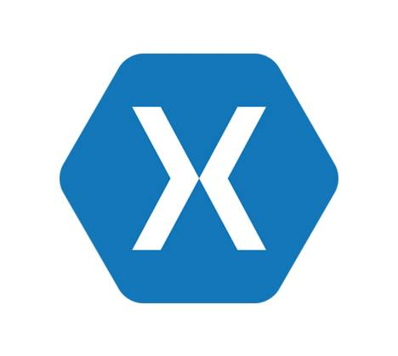
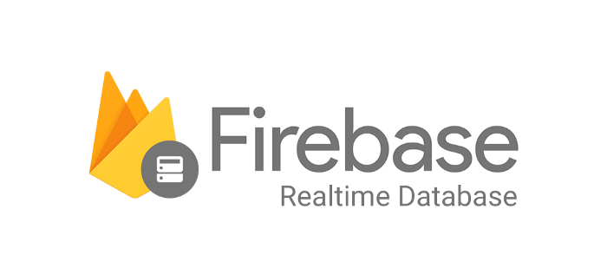

Slide 3

Firebase
Develop
Firebase Cloud Messaging
Firebase Auth
Firebase Realtime Database
Firebase Cloud Firestore
Firebase Hosting
ML Kit
Analytics
Firebase Analytics
Stability
Crashlytics
Performance
Firebase Test Lab for Android And iOS
Earn
Admob

Slide 4
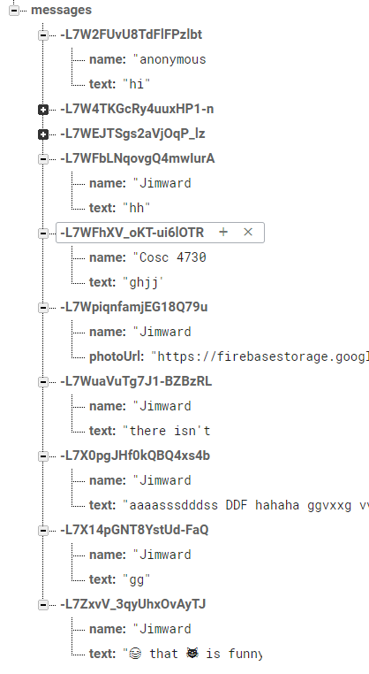
Firebase Realtime Database
A cloud-hosted NoSQL database.
The data is stored a json objects.
Handles the complexity of real time synchronization and provides flexible conflict resolution
Accessible directly from client SDKs, or from your server with the REST API

Slide 5
Demo

Slide 6




THANK YOU
Anbu Mani
Associate Technical Analyst
https://xmonkeys360.com
@Anbu_Mani27
@AnbuMani27
@AnbuMani27
@AnbuMani27

